Slide 1
Etiology, Diagnosis, and Systems Management of Osteoporosis:
Avery M. Jackson III MD, FACS, FAANS
OB/GYN resident lecture series
April 11, 2019
Michigan Neurosurgical Institute

Slide 2
Presenter
Avery M Jackson III MD FAANS FACS
Board certified Neurosurgeon
Michigan Neurosurgical Institute PC
Founder, Chief Executive officer
MNI Great Lakes ECHO LLC
Founder, Chief Executive Officer

Slide 3
Disclosures
National Osteoporosis Foundation Ambassador
National Bone Health Alliance
Consultant/lecturer
Medtronic
Consultant/lecturer

Slide 4
Etiology
Good summary from University of Connecticut Health Center: Musculoskeletal Institute
J Clin Invest. 2005 Dec 1; 115(12): 3318–3325.
doi: 10.1172/JCI27071
PMCID: PMC1297264
PMID: 16322775
Pathogenesis of osteoporosis: concepts, conflicts, and prospects
Lawrence G. Raisz

Slide 5
Diagnosis of Osteoporosis
Bone Density
T-score < -2.5
At femoral neck, total hip, or lumbar spine
Low Trauma Fracture
femoral neck, spine, or distal radius
over the age of 50 years

Slide 6
“Hip fractures could be opportunities to identify and treat osteoporosis. Yet few patients receive timely services.”
“Women 80 years and above are 1/3 less likely than those 50-79 to receive osteoporosis-related services after hip fracture.”
“Only 20% of women age 50 and above with hip fractures receive recommended osteoporosis-related services.”
www.aarp.org/ppi/info-2016/few-hip-fracture-patients-receive-osteoporosis-care.html

Slide 7
Back Pain
Bed Rest:
The Downward Spiral
Spinal Deformity
Decreased Lung Capacity
Impaired Function
Sleeping Problems
Loss of Appetite
Decreased Activity
Increased Fracture Risk
More Bone Loss
Increased Lung Problems, Co-morbidities
Increased Mortality

Slide 8
USPSTF Clinical Evidence Gaps
U.S. Preventive Services Task Force. “Fifth Annual Report to Congress: High-Priority Evidence Gaps for Clinical Preventive Services.” November 2015.

Slide 9
However, Osteoporosis Care Still Lags FAR BEHIND Other Major Diseases/Conditions (2013 HEDIS HMOs)
National Committee on Quality Assurance, “The State of Health Care Quality 2014”. 2014.

Slide 10
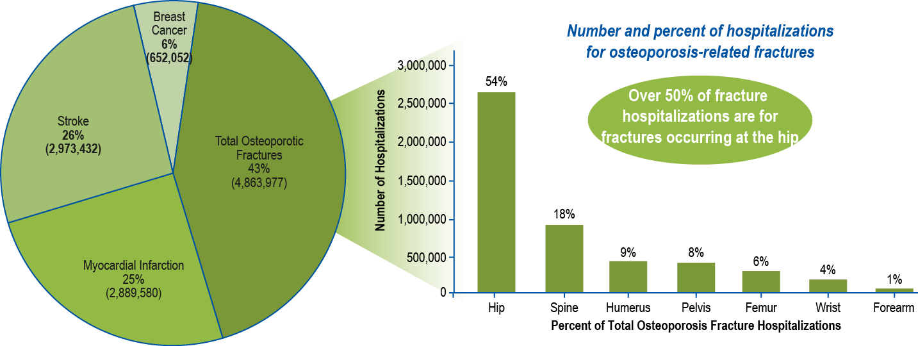
Hospitalization Burden for Osteoporotic Fractures and Other Serious Diseases in Older U.S. Women
Percent of hospitalizations* for osteoporotic fractures and other serious diseases combined, 2000–2011
*Principal diagnosis codes were used
Singer AJ, et al. Osteoporosis International 2014. 25(4) suppl: 503-522
Singer AJ, et al. Mayo Clinic Proceedings 2015. 90; 53-62

Slide 11
A Public Health Emergency
NOF: Overwhelming evidence shows that osteoporosis is a massive public health problem nationwide;
Nearly 65 percent of people in this country who are 65 years old and older have osteoporosis or low bone mass and are at risk for a fracture, according to data from the Centers for Disease Control.
Currently only 25 percent of patients who suffer a fracture are treated to reduce the risk of future fractures.
Hip fracture patients’ use of osteoporosis medications following fracture decreased from 40 percent to 21 percent between 2002 and 2011.

Slide 12
Healthcare Professional Gaps in Knowledge
Lack of understanding: connection between osteoporosis/low bone mass and bone breaks
Of the 100 most commonly used ICD-9 codes in 2010 (as defined by AAFP), osteoporosis was not one of them*
Most common problems
Hypertension Depression/Anxiety
Angina/Heart disease Back pain
Diabetes Arthritis
Asthma COPD
Time constraints
Knowledge gaps: diagnosis/use of therapies
Conflicting information/recommendations
No primary “home” specialty for bone health
* http://sagemb.com/info-resources/medical-billing-reference/95-100-most-common-diagnosis

Slide 13
Significance of Osteoporosis-Related Fractures
2,000,000
2,050,695¹
296,610 hip
1,500,000
396,961 wrist
674,919 other sites
Annual incidence of common diseases
1,000,000
750,000²
795,000²
134,779 pelvic
610,000
new
strokes
185,000
recurrent
550,000
new
attacks
500,000
547,426
vertebral
249,260³
200,000
recurrent
attacks
0
Osteoporotic
Stroke
Breast Cancer
Fractures
Heart Attack
1Annual fracture incidence age 50+
2Annual estimate new & recurrent MI ages 35+
2Annual estimate new & recurrent stroke all ages
3 2014 new cases in situ & invasive breast cancer all ages
1 Burge, et al. JBMR. 2007. 465-75.
2 American Heart Association. Heart Disease and Stroke Statistics – 2016 Update.
3 American Cancer Society. Surveillance Research. 2016.

Slide 14
KEY FACTS ABOUT SECONDARY FRACTURES
A prior fracture almost doubles a patient’s future fracture risk
Half of patients presenting with hip fractures have suffered a prior fracture
Despite the risk of future fractures, the majority of fragility fracture patients are neither assessed, nor treated to reduce fracture risk.
To achieve a significant reduction in future fracture rates and resulting health care costs, healthcare systems must target those patients who have already suffered a fracture, as they are the ones at highest risk for future fractures.

Slide 15
The Care Gap
Missed opportunities for osteoporosis assessment & treatment after fracture, even more so in diverse populations and in men
Fragmented health care system – Fracture patients get “lost” from hospital to rehab to nursing home to home to primary care provider
FLS programs have been proven to work to reduce this gap – FLS is a system of patient-centered, coordinated care that follows the patient throughout the care pathway to ensure adequate assessment and treatment.
Centers for Disease Control and Prevention, Administration on Aging, Agency for Healthcare Research and Quality, and Centers for Medicare and Medicaid Services. Enhancing Use of Clinical Preventive Services Among Older Adults. Washington, DC: AARP, 2011.
NCQA. Improving Quality and Patient Experience: The State of Health Care Quality 2013.

Slide 16
FLS Care Coordination in Action
FLS Coordinator/ Physician Champion
Primary Care
Medical Specialists
Nursing, physical therapy, nutritionist
Hospital/
Emergency Department
Orthopaedics

Slide 17
Project ECHO
A strategy of medical education and care management using videoconferencing technology with interactive case-based learning
ECHO aims to democratize medical knowledge and develop specialty care capacity in underserved communities
Established at University of New Mexico in 2003 with chronic hepatitis C as the model disease
Arora S et al. N Engl J Med. 2011;364:2199-2207
Now over 100 “hubs” and 7 “super hubs” in 12 countries for 45 diseases, and rapidly expanding
Goal: To touch 1 billion lives by 2025
http://echo.unm.edu/

Slide 18
PROJECT ECHO: BONE HEALTH

Slide 19
>90% fragility fracture patients assessed
The journey toward
best practice
Notes:
Incremental development of FLS
Aim: Identify, investigate and treat, where appropriate, all women and men 50 years of age and older with low trauma fractures for the prevention of secondary fractures.

Slide 20
www.FracturePreventionCENTRAL.org
More than 3,800 individual users have signed up to access
these tools
since March 2013

Slide 21
www. greatlakes–echo.com ajackson@Greatlakes-echo.com adonnell@Greatlakes-echo.com

Slide 22
THANK YOU
Any Questions?

